Slide 1
CS440/520 Artificial Intelligence
Computer Science Department
Lecture 8:
Logic-based Inference and Satisfiability
25 September 2014
Instructor: Kostas Bekris

Slide 2
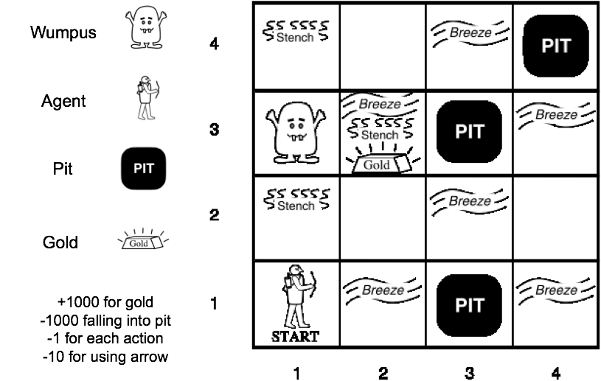
Binary CSP example: Wumpus World

Slide 3
Truth Tables
P | Q | ¬P | P∧Q | P∨Q | P⇒Q | P⇔Q
FALSE | FALSE | TRUE | FALSE | FALSE | TRUE | TRUE
FALSE | TRUE | TRUE | FALSE | TRUE | TRUE | FALSE
TRUE | FALSE | FALSE | FALSE | TRUE | FALSE | FALSE
TRUE | TRUE | FALSE | TRUE | TRUE | TRUE | TRUE

Slide 4
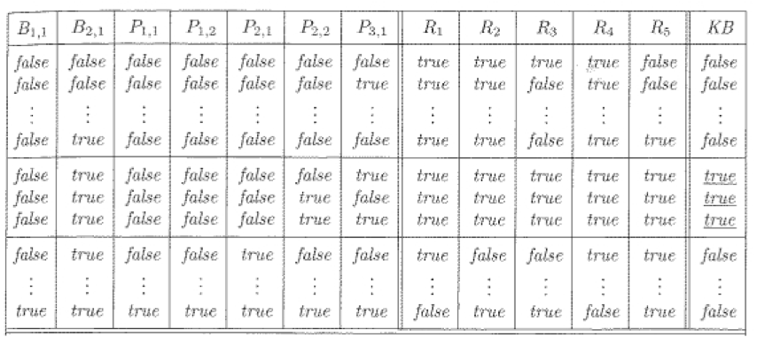
Truth Table for Wumpus World

Slide 5
Wumpus World

Slide 6
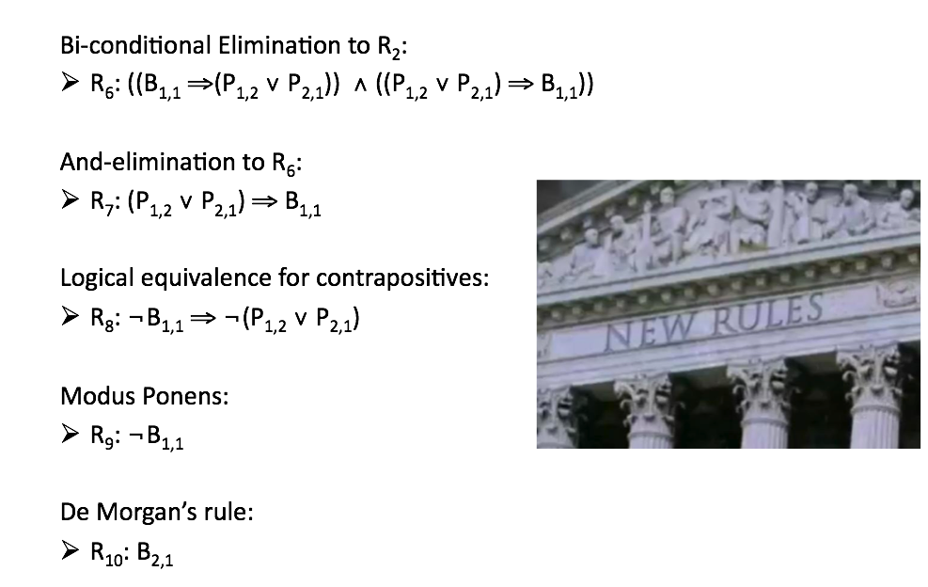
Using Logic to Develop New Rules

Slide 7
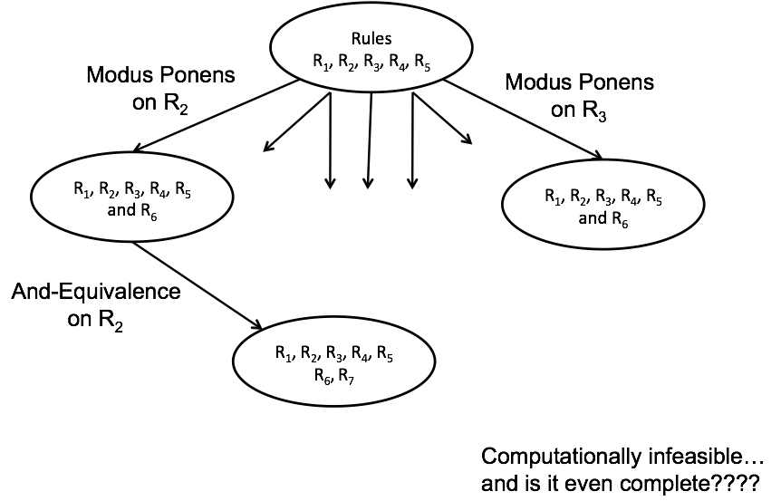
Searching with Logical Inference

Slide 8

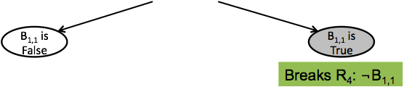
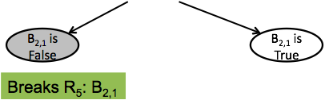
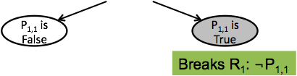

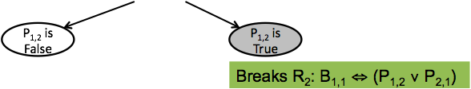
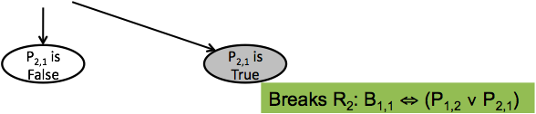



Backtracking on Variables

